Slide 1
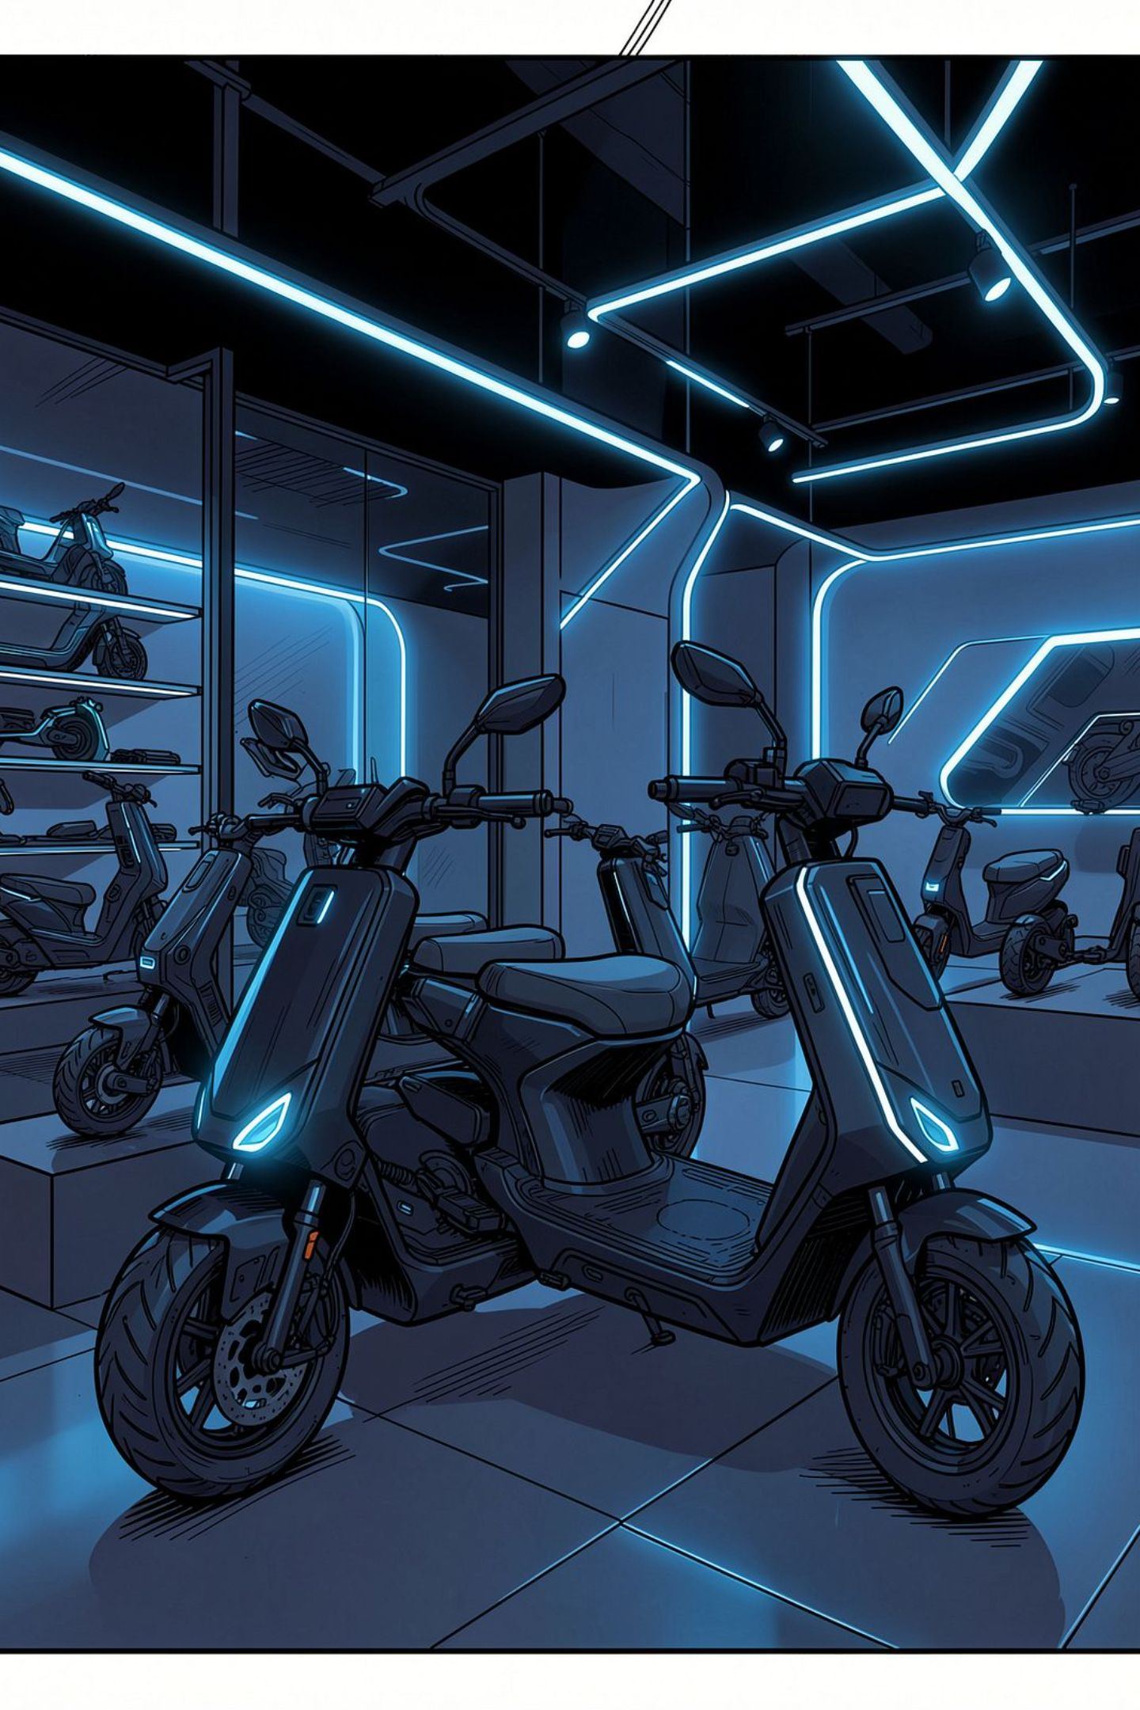
OLA Electric Chatbot using IBM Watson Assistant
MBA Project Presentation | Developed by: Jaijyot and Sidhant

Slide 2
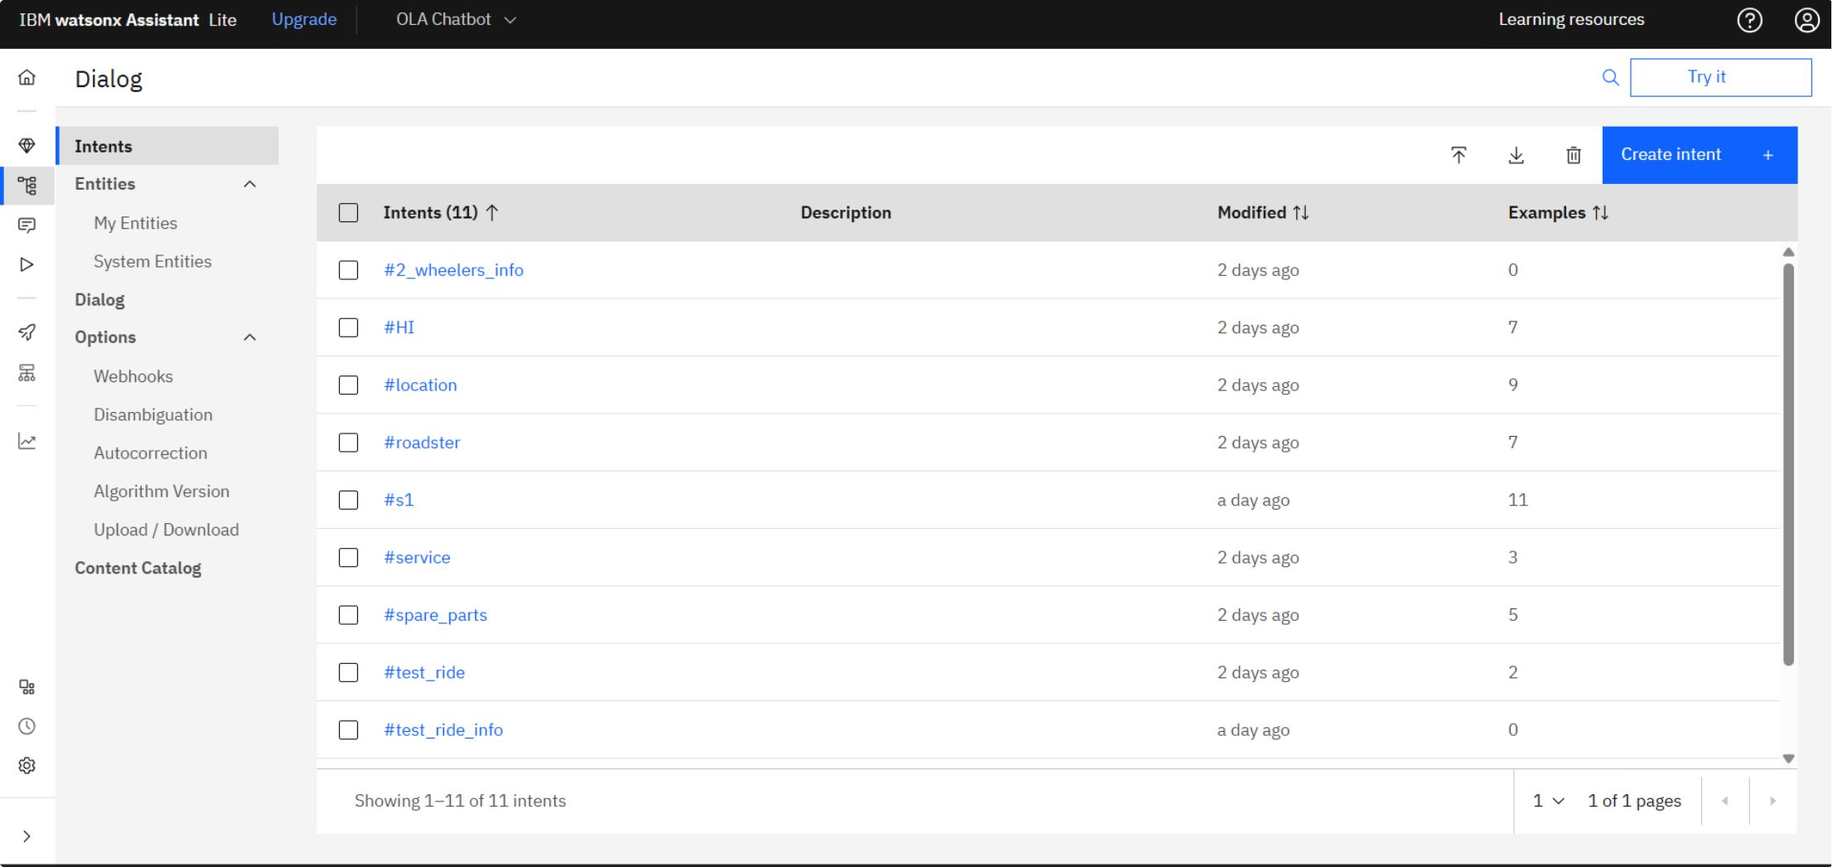
Intents
Vehicle Intents
Greeting Intent
Vehicle_info, Roadster, S1 — model-specific product queries
HI intent detects opening messages and initiates conversation
Test Ride Intent
Support Intents
Test_ride intent triggers the automated booking workflow
Service and Spare_parts intents handle after-sales queries

Slide 3
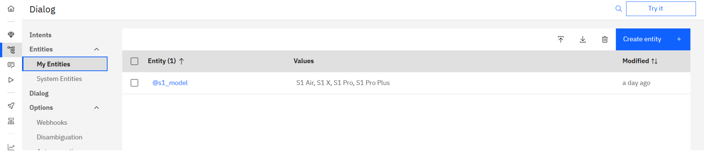

My Entities
Custom Entity: @s1_model
Custom entity @s1_model created for OLA model recognition
Values defined: S1 Air, S1 X, S1 Pro, S1 Pro Plus
Enables model-specific query recognition
Improves chatbot accuracy and response precision
Custom entities allow the chatbot to pinpoint exactly which OLA scooter model the customer is asking about.

Slide 4
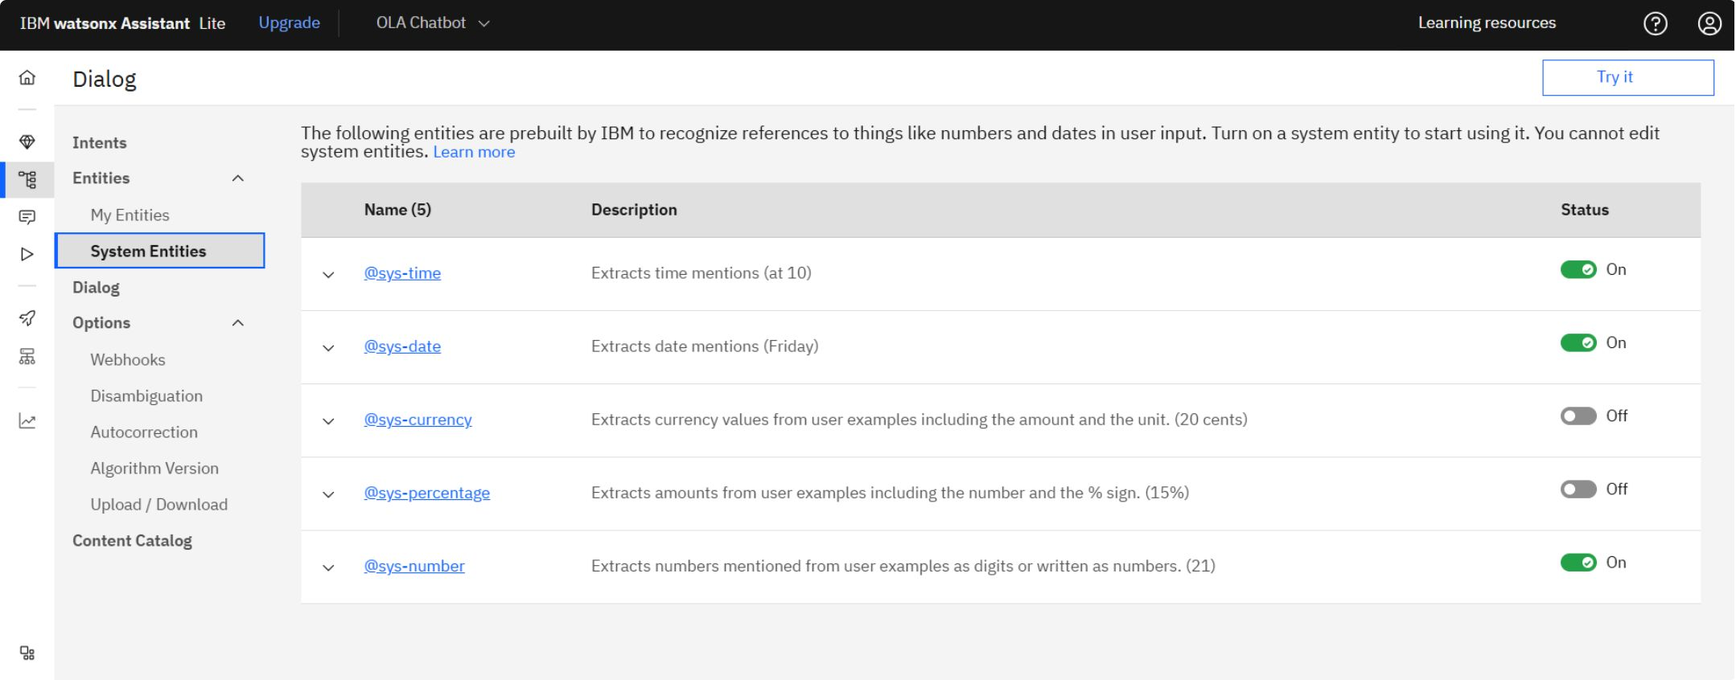

System Entities
Pre-Built Watson System Entities
All three entities are essential for the test ride booking process and automatic entity extraction is enabled.
@sys-date
@sys-time
@sys-number
Automatic date extraction from user input
Automatic time extraction for scheduling
Numeric value recognition and validation

Slide 5
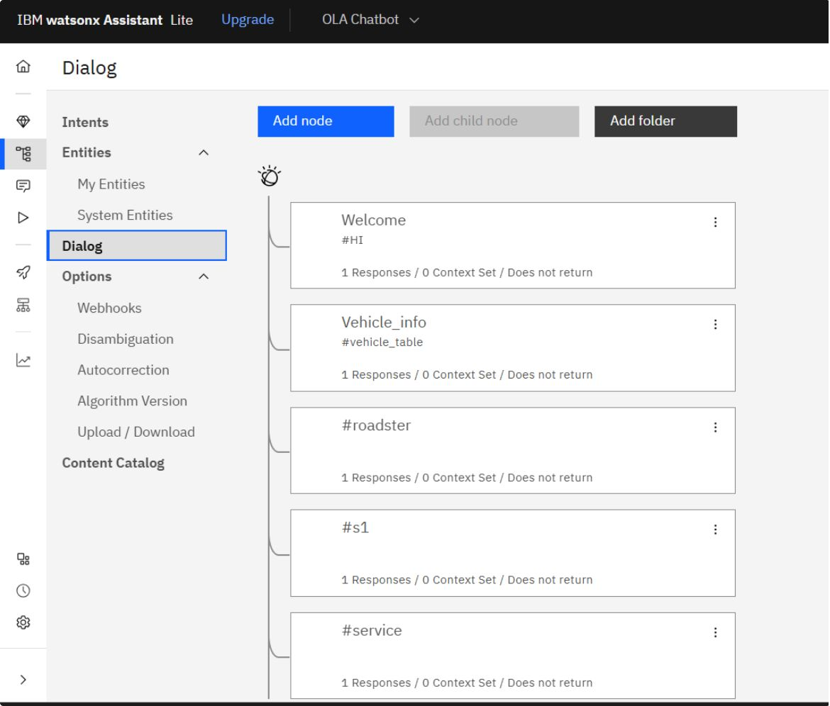
Dialog Nodes — Part 1
Welcome
Vehicle_info
Initial greeting and chatbot introduction
General product information and portfolio
Roadster & S1
Service
Model-specific details and specifications
Support, maintenance, and service queries

Slide 6
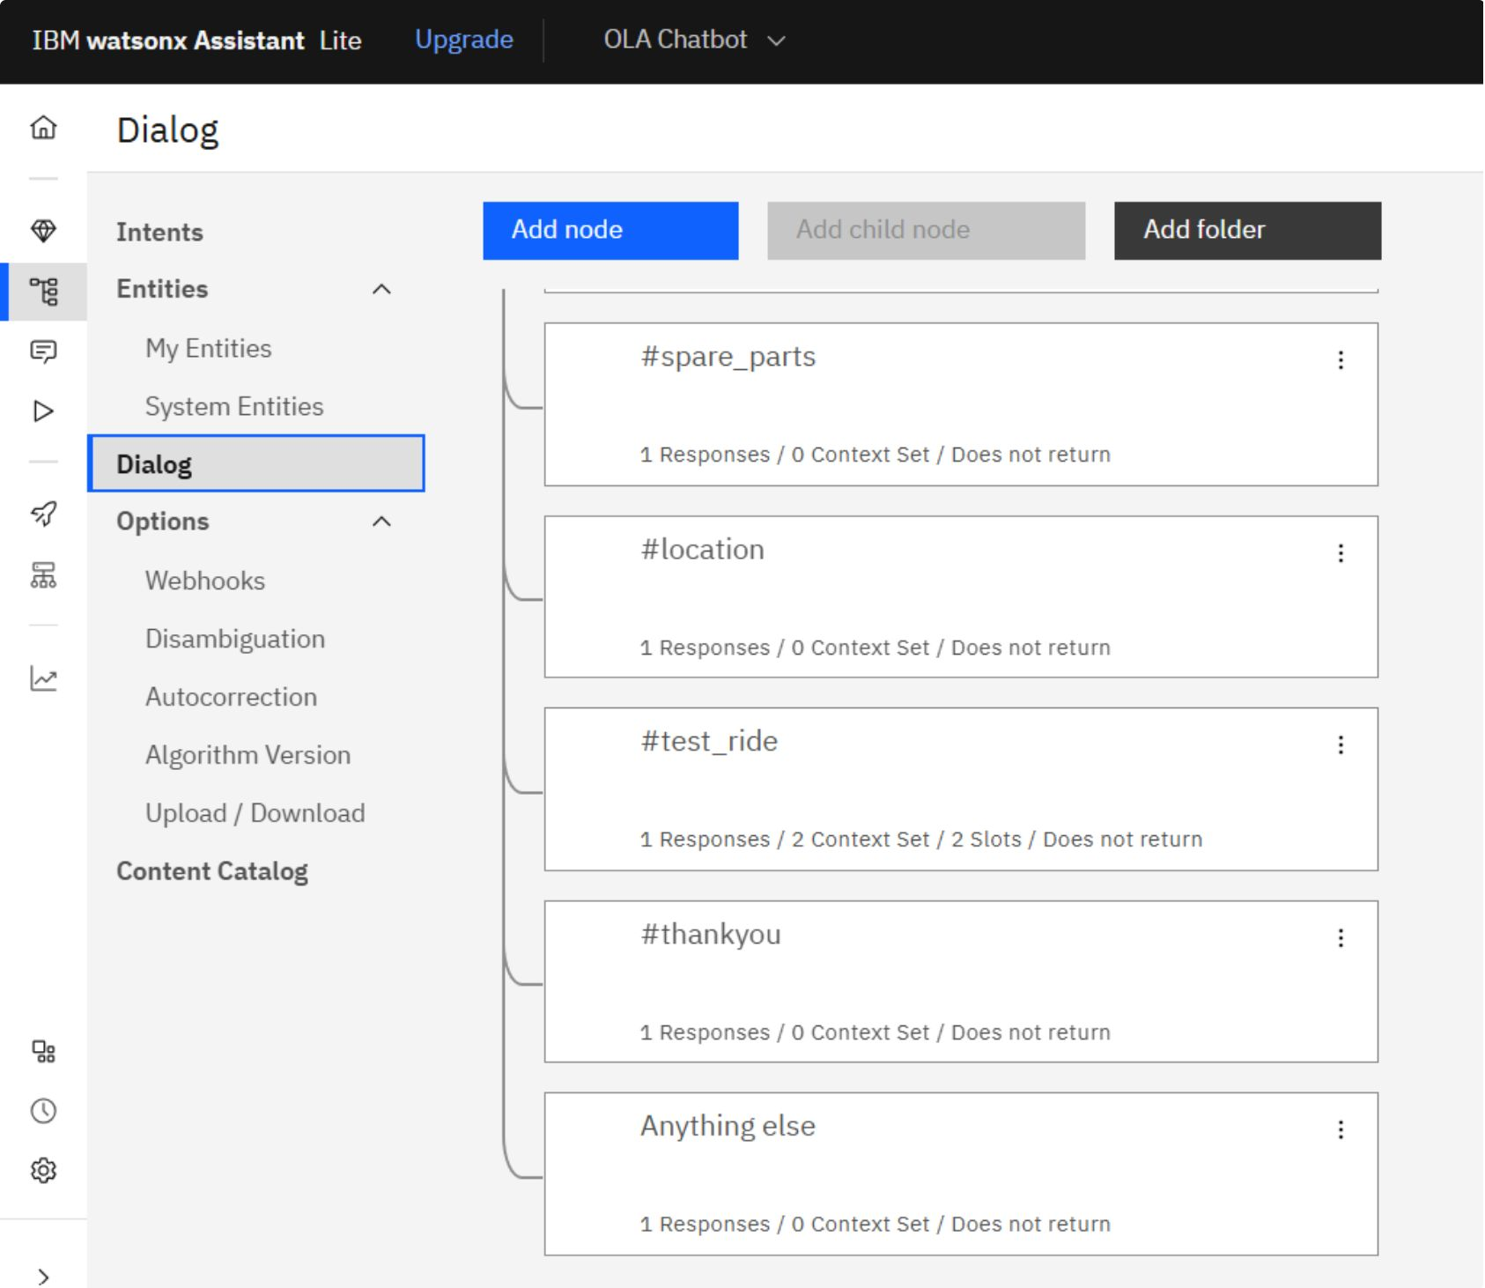
Dialog Nodes — Part 2
Completing the Conversation Flow
Test_ride: Automates the ride booking workflow
Location: Helps users find the nearest showroom
Spare_parts: Delivers parts availability information
Thank_you: Graceful conversation closure
Anything_else: Fallback handling for unrecognized inputs

Slide 7
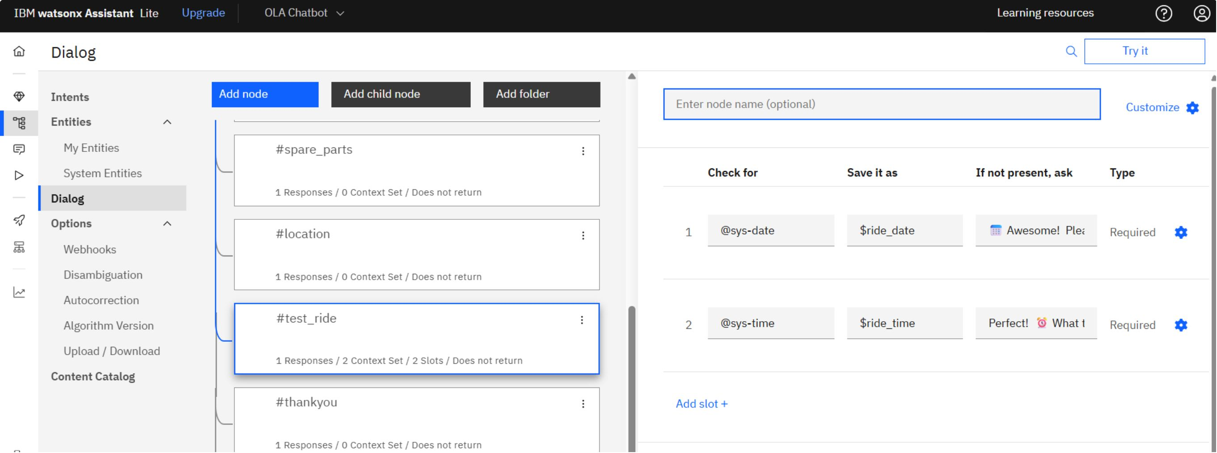
Test Ride Slots — Slot Filling
Date Collection
Time Collection
Uses @sys-date to extract preferred test ride date
Uses @sys-time to extract preferred appointment time
Validation
Confirmation
Ensures complete information before processing the booking
Automatic booking confirmation sent to the customer

Slide 8
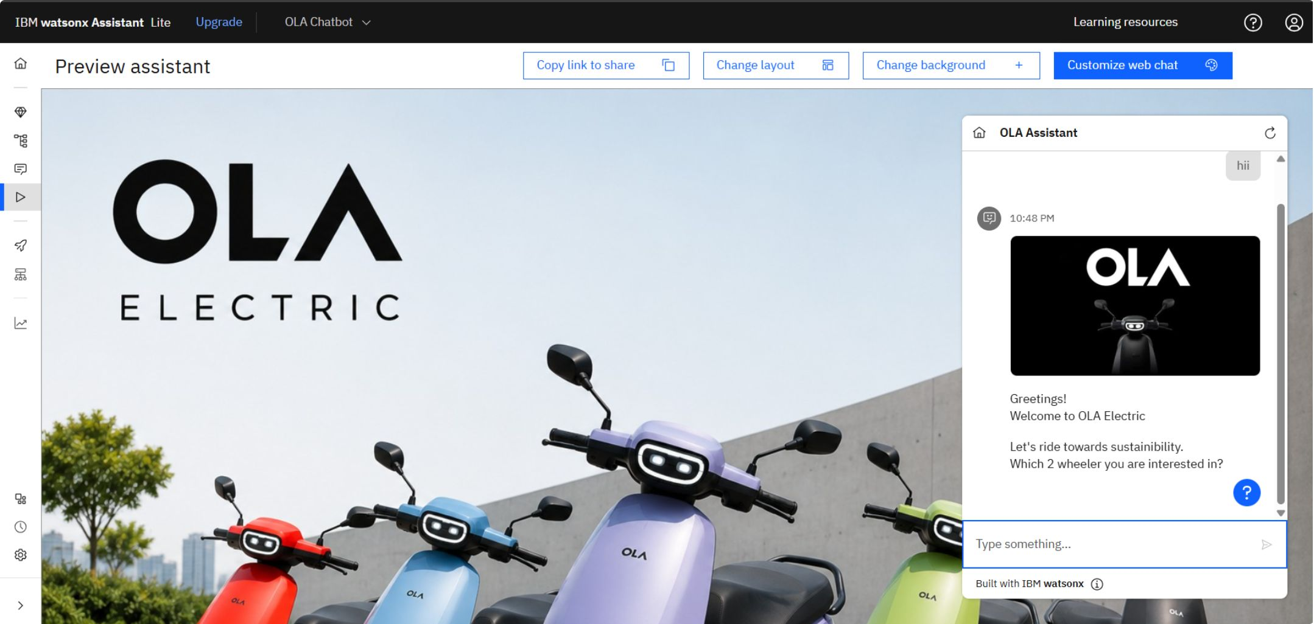
Final Chatbot Interface
Key Highlights
Welcome screen with OLA branding and scooter imagery
Professional, clean chat interface design
User-friendly interaction experience
Seamless IBM Watson Assistant integration
Responsive layout optimized for customer engagement

Slide 9
Technology Stack
Core technologies powering the OLA Electric Chatbot built on IBM Watson Assistant.
Technology | Purpose
IBM Watson Assistant | Core chatbot development and NLP platform
IBM Cloud | Cloud deployment and hosting infrastructure
Intents | User query recognition and intent classification
Entities | Data extraction and entity recognition (custom & system)
Dialog Nodes | Conversation flow logic and response control
Slots | Information collection, validation, and booking automation
NLP | Natural language processing and user intent understanding

Slide 10
Conclusion
Project Outcomes
Thank You
Successfully developed an OLA Electric chatbot
Implemented IBM Watson Assistant for conversational AI
Configured intents, entities, nodes, and slots effectively
Automated customer interaction and support workflows
Improved customer experience with instant, accurate responses
Developed by Jaijyot Singh
MBA Project | OLA Electric Chatbot | IBM Watson Assistant

